Slide 1

ECE 382V: QUANTUM COMPUTING SYSTEMS:
A SOFTWARE/ ARCHITECTURE PERSPECTIVE
QUANTUM ERROR CORRECTIOn
POULAMI DAS
ECE, The University of Texas at Austin

Slide 2
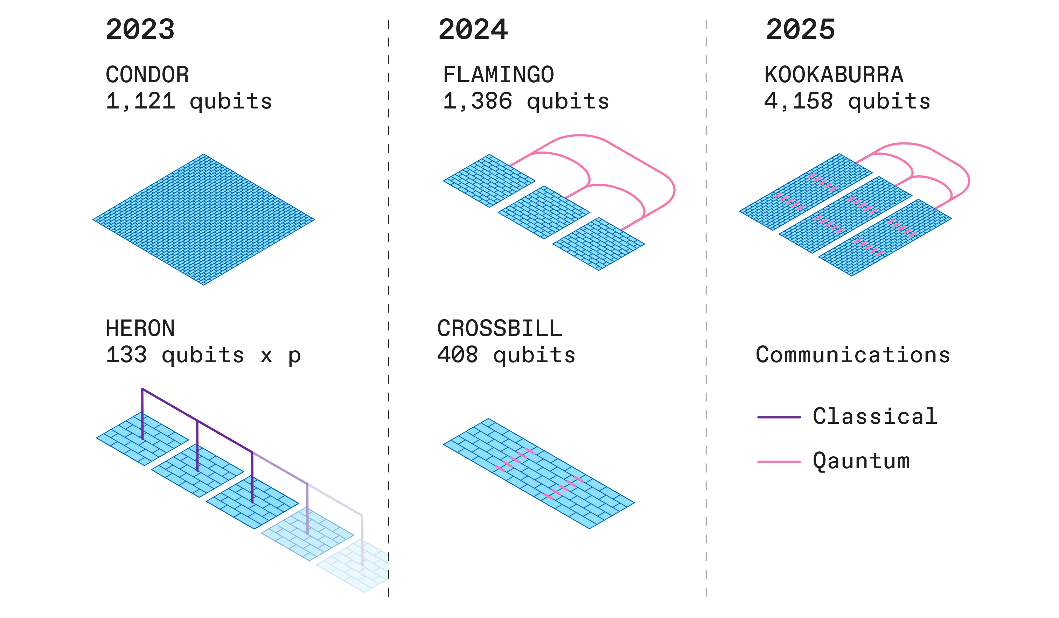
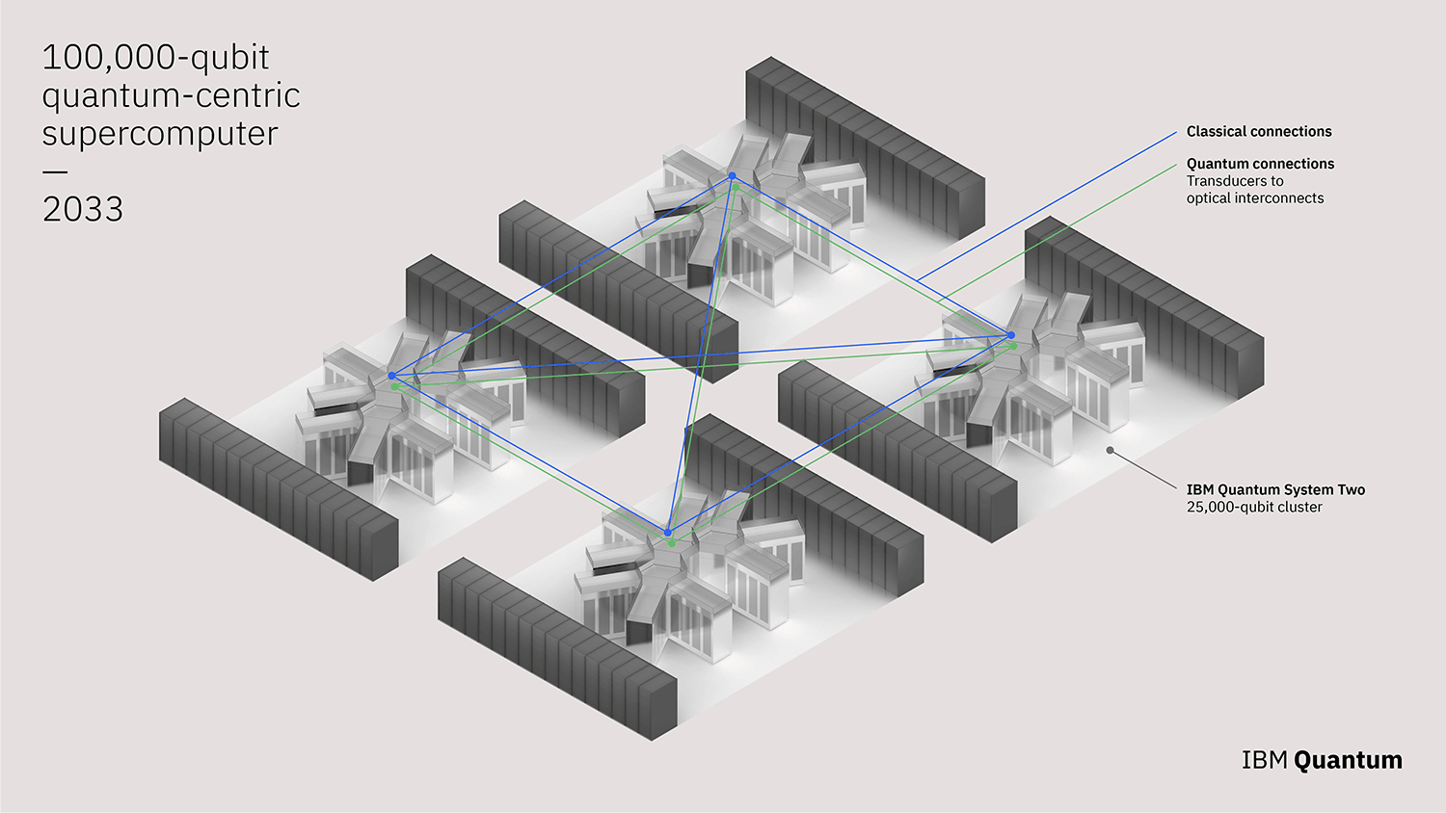
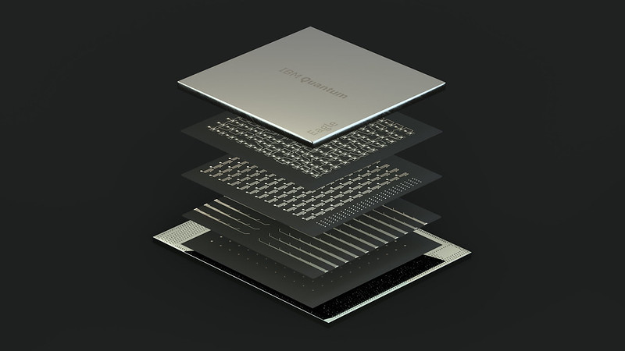

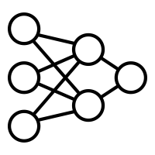
Applications To Devices Gap
~400 qubits
p = 0.5%
~4000 qubits
p = 0.1%
~100K qubits
p = 0.01%
Applications-at-scale
p < 10⁻¹⁵
2023
2026
203X
Goal
Significant gap in error rates!
Most practical quantum applications require error-rates far below device error-rates

Slide 3

Triple Modular Redundancy (TMR)
Replicate 3 times: 0 as 000, 1 as 111
Triple Modular Redundancy
1
1
1
0
Classical bit
Copy
Majority
Measure
Tolerate single-bit errors
What happens if double-bit failures happen?

Slide 4

Triple Modular Redundancy (TMR)
Replicate 3 times: 0 as 000, 1 as 111
Triple Modular Redundancy
0
1
1
1
0
Classical bit
Copy
Majority
Measure
Tolerate single-bit errors
Cannot tolerate double-bit errors
TMR can only tolerate single-bit errors

Slide 5
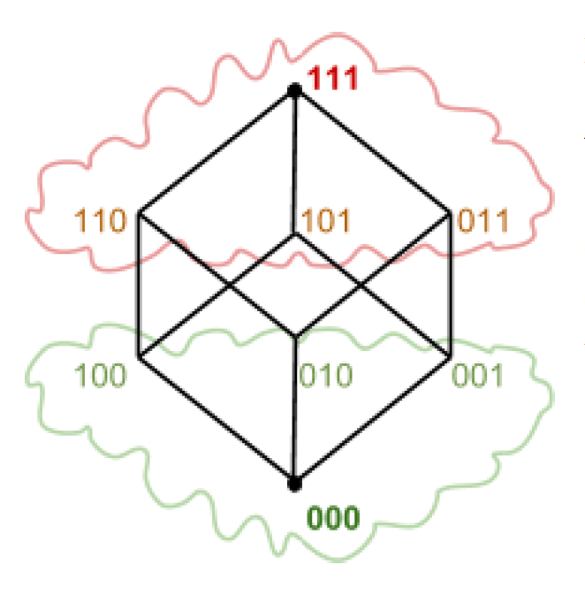
Errors Represented As Code-Words
Single-bit Errors
Double-bit Errors
Correctable/uncorrectable errors fall into groups of valid/Invalid code-words in Hamming space

Slide 6
Increased Redundancy For Greater Fault-Tolerance
Replicate 5 times: 0 as 00000, 1 as 11111
5MR
Triple Modular Redundancy
1
0
1
1
0
1
Classical bit
Copy
Majority
Majority
Measure
Tolerate single-bit errors
Tolerate double-bit errors
TMR can correct a single bit failure, 5MR can correct two bit failures

Slide 7
Code Distance
000
HD-0
111
HD-3
001,010,100
HD-1
011,110,101
HD-2
How does this look for 5MR?

Slide 8
Code Distance
00000
HD-0
11111
HD-5
00001…
HD-1
00011…
HD-2
00011…
HD-3
01111…
HD-4
A code of distance d corrects up to (d-1)/2 errors

Slide 9
Quantum Error Correction
Quantum error correction is fundamentally different from classical methods
Triple Modular Redundancy
1
1
1
0
Quantum bit
Classical bit
Copy
Copy
Majority
Measure
Measure
Tolerate single-bit errors
QEC needs an approach different from classical techniques

Slide 10
Repetition Code
q[0]
q[1]
q[2]
1
0
1
0
0
0
None
1
0
q[0]
1
1
q[1]
0
1
q[2]
This repetition code can correct bit-flip errors

Slide 11
Shor 9-bit Code
High redundancy, computation is hard using Shor’s code [X,Z are easy]

Slide 12
Steane 7-bit Code
Lower redundancy than Shor’ code, computation of T is still hard [X, Z, CNOT, and H are easy]

Slide 13
Recursion For Greater Fault Protection?
b
b
b
b
b
b
b
b
b
b
b
b
b
TMR
b
b
b
TMR-of-TMR
What is the minimum number of errors that can cause the TMR-of-TMR to fail?
Concatenation code: Take a qubit and encode it in the 7-qubit Steane code.
Take each physical qubit that is part of the logical qubit & RE-ENCODE in 7-qubit code
Greater redundancy for greater fault protection

Slide 14
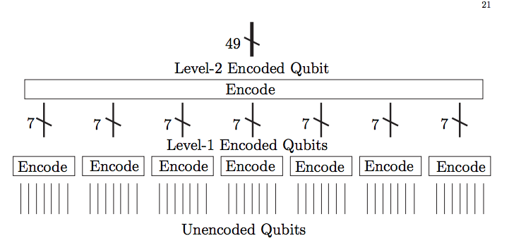
Steane 49-bit Code
Steane 49-bit code can correct up to 4 errors

Slide 15


Quantum Error Correction: Overview
QEC involves syndrome (parity) extraction and decoding to identify errors
Decoder
1
Instructions to generate syndrome
3
Correction
2
Syndrome
2
Send syndrome to decoder
01…….01
Control
Processor
Readout
Interface
Did an error occur?
1
Where did the error occur?
QEC
Instructions
What was the type of error?
Qubits
3
Send correction to control processor
Errors are detected by using syndrome extraction and decoding the syndromes

Slide 16
Quantum Error Correction: Unique Challenges
Huge redundancy
Must be very fast
Imperfect process
System-level challenges
High overheads
(operations, qubits)
Operations at scale
Low coherence
Errors quickly accumulate
Both instruction delivery and decoding
Incorrect parities
Complex errors
(correlated, leakage)
Bandwidth
Cryogenic
Latency
Low overhead codes
Faster decoders (approx. algo., hardware)
Handling via decoding, scheduling
uarchitecture, compression, multi-level design
Significant amount of research effort in QEC

Slide 17
Quantum Error Correction Codes: Performance Metrics
Redundancy (lower is better), structure
Decoder (easy to decode*)
Hardness of operations
Threshold
Steane code over Shor code
Surface codes over Color codes
Steane code over Shor code
*Depends on decoding strategy
P_{logical} < P_{physical} only if
P_{physical} < P_{threshold}
Surface codes over Color codes
QLDPC codes over surface codes
Surface codes over QLDPC codes
Surface codes(grid) over QLDPC codes
Which QEC code is the best depends on many factors. Surface codes widely considered most promising due to its grid structure, polynomial time decoding algorithm, and high threshold.

Slide 18



QEC @ Scale: Need System-Level Thinking
Existing decoders do not account for the system-level constraints
Room temperature
(Outside dilution refrigerator)
Decoder
4 K
(Inside dilution refrigerator)
Correction
Syndrome
Large bandwidth
Control
Processor
Readout
Interface
More noise
4 K
Number of wires
QEC
Instructions
100s Gbps
Inefficient
Large Distances, 100s-1000s of Logical Qubits
15-20 mK
(Inside dilution refrigerator)
How do we design the control processors? How do we transmit information?

Slide 19
Rest Of QEC Discussion: Overview
Surface codes and decoding surface codes
Approximate decoding techniques for surface codes
Bandwidth challenges in QEC [both control and decoding]
QEC demonstrations and focus on eliminating certain types of errors [leakage]
Mapping surface codes to non-grid lattices [Grid surface code on IBM’s heavy-hex lattice]
QLDPC codes [Guest lecture by Nicolas Delfosse from Microsoft]

